Slide 1

Quick Bites- Smart Canteen Management
Group members with Student Id
RAZZAK ANSARI-24107097
BHOOMI LOKHANDE-24107078
MIHIR DESHMUKH-24107049
VISHAL CHAUHAN-24107072
Project Guide
Ms.Richa Singh

Slide 2
Contents
Introduction
Objectives
Scope
Features / Functionality
Project Outcomes
Technology Stack
Block Diagram if applicable

Slide 3
1. Introduction
Problem Identified :
Long queues in canteens during breaks
Difficulty managing orders manually
Solution Proposed :
Mobile application for viewing menu and placing orders
Digital system for order management and notifications

Slide 4
2. Objectives
1. To develop a mobile application that allows customers to view the canteen menu and place orders online.
2. To reduce waiting time and congestion in the canteen using digital ordering.
3. To allow canteen staff (admin) to efficiently manage the digital menu by updating item availability in real time.
4. To enable the admin to notify customers when their order is ready, ensuring smooth and organized order delivery.

Slide 5
3. Scope
Applicable in colleges, schools, and office cafeterias
Scalable system for handling multiple users simultaneously
Can be extended with features like:
-Online payments
-Order tracking
-Analytics for canteen management

Slide 6
4. Feature /Functionality
User Module: Secure Sign-up/Login via College ID, categorized Menu Search (Name/Category), and real-time Order Status Notifications.
Admin Module: Dynamic Menu Management (Add/Update/Delete items) and a live dashboard to track daily income and total orders.

Slide 7
5. Outcome of Project
Users can view the canteen menu through the app.
Users can add items to cart and place orders.
Admin can manage the menu digitally.
System reduces waiting time in the canteen.
Provides a smoother and organized order system.

Slide 8
6. Technology Stack
Frontend (GUI): Flutter
Backend : Spring Boot
Database : MySql
Platform: Android Mobile Application
Tools used:
1.github- version control
2.insomnia- API testing

Slide 9
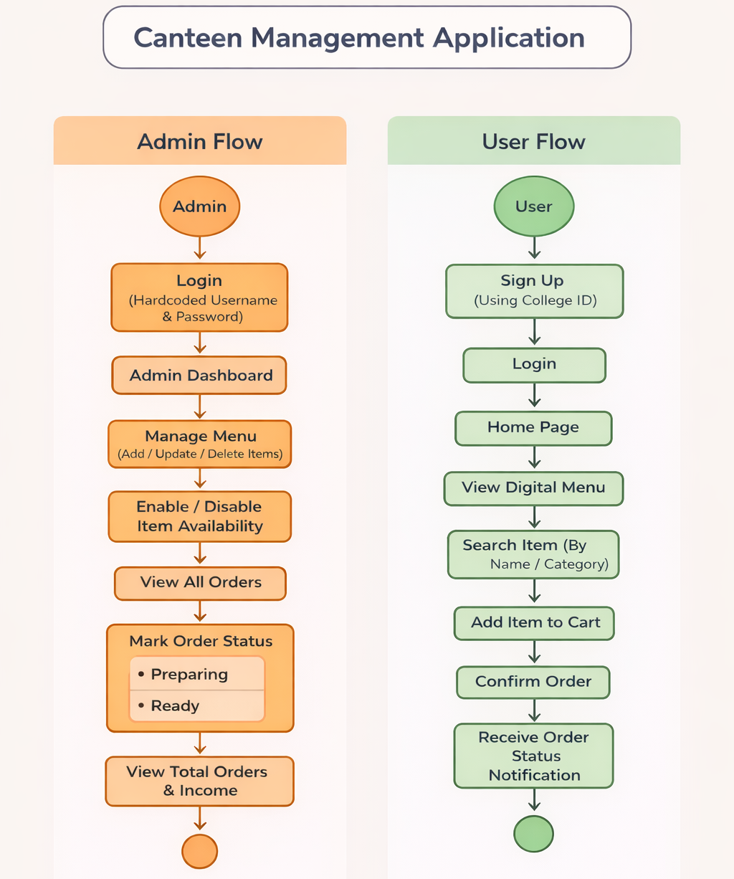
7. Block Diagram ( if applicable)

Slide 10
Take a Look

Slide 11
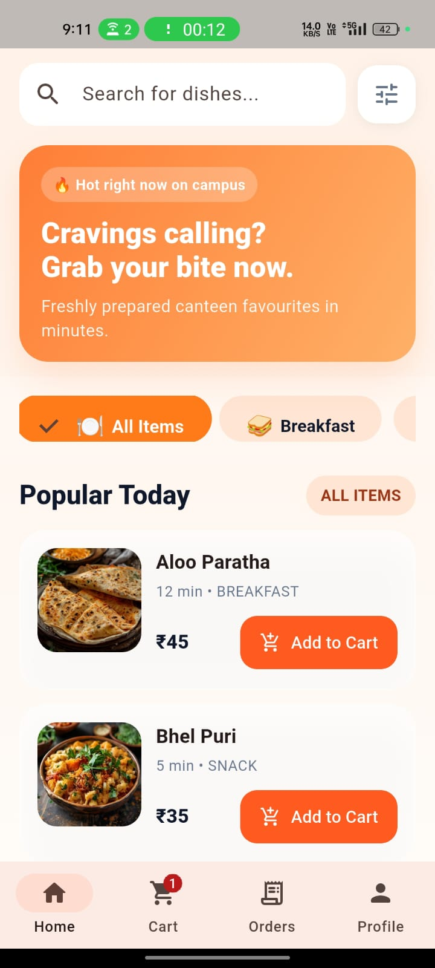

Slide 12
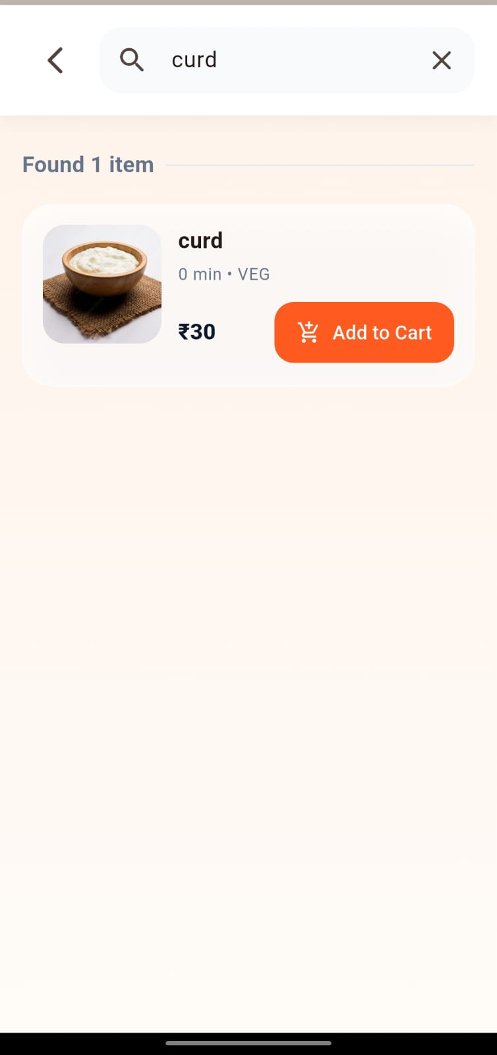

Slide 13
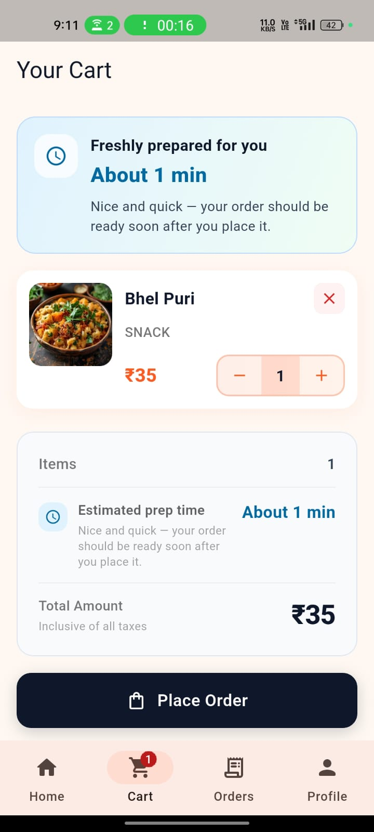

Slide 14
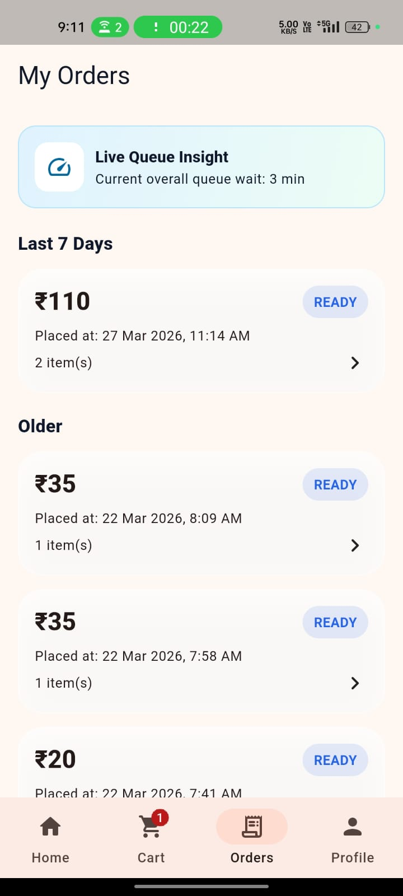

Slide 15
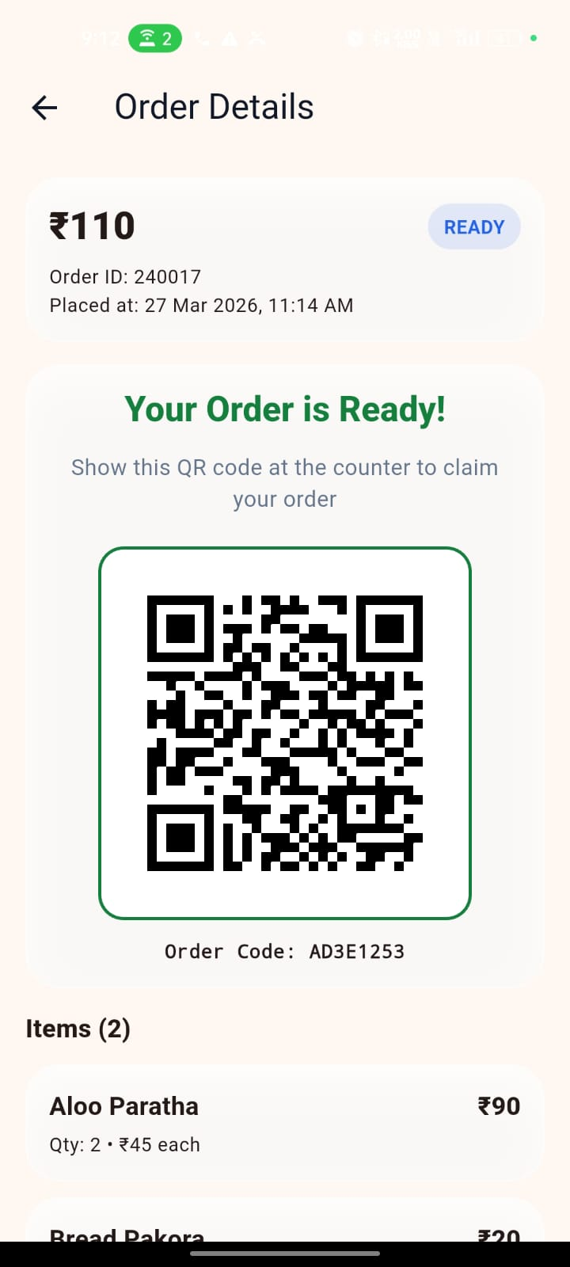

Slide 16
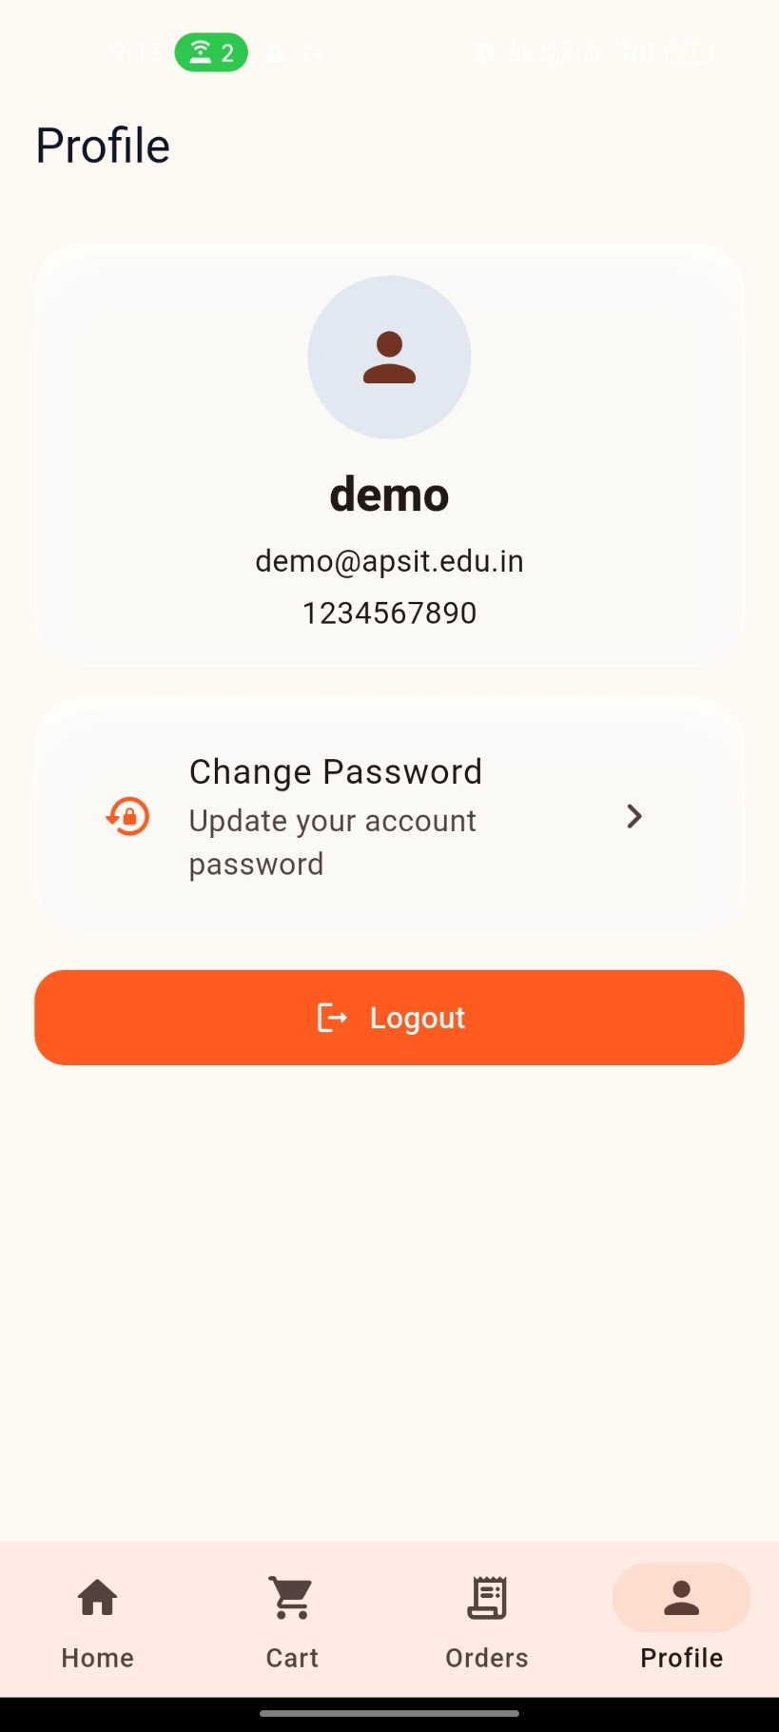

Slide 17
Thank You...!!

